Slide 1
Registration Template
Prepared for ZS PRIZE Participants
October 14, 2022
This document is solely for the use of client personnel. No part of it may be circulated, quoted or reproduced for distribution outside of the client organization without prior written approval of ZS.
Bangalore +91 080 6773 3700

Slide 2

Table of Content
Executive Summary
Deep dives

Slide 3
Executive Summary: Describe your idea in not more than 400 words; this should be like your 2–3-minute pitch to the investor
By this year end, the Indian Healthcare Industry will reach a market evaluation of 372 billion dollar but still even the basic and paramount health virtuosos are kept hidden from a major portion of the population. A 2019 survey conducted in India revealed that more than 37 percent of respondents suffered from at least one health condition, whereas almost 23 percent reported one or more health conditions.
First part of the approach is to Spread the Word with an intention is to extend the reach is Creating Awareness via Doctors, Media, Advertisement, Social Platforms, Celebrities, Government - Organizing Free Health Camps/ Checkup via Hospital, Government and Private Organizations. Aware the locals about the symptoms, criticality and remedies for the chronic diseases along with the measure to promote a healthy lifestyle. Second part of the approach is via Building Web Application (Control Center For Promoting and Creating Awareness on Health Issue):
Displaying details of all the health issues at International and National Level with their Symptoms, Causes and Remedies (if, discovered).
The application will detect the location/ region and display a dashboard illustrating the details on fluctuating cases of diverse diseases in the locality, providing measures to be taken at different criticality level of a disease.
Grouping the people with their disease and providing them with diseases curable meals and medications – as prescribed by the Routine Doctors, with advice for regular follow up checkup via monitoring the routine of the patients complemented by Free Health Camps.
Forwarding a proposal to collaborative at International, National and Sub-National levels to form a committee under WHO to closely monitor diseases from detection to finding cure.

Slide 4
Deep dives: Please elaborate on the below in not mare than 400 words or 1-2 slides on each (Do provide any available demos, videos, POCs or existing research with your response)
Problem statement– What is the need? Why is the problem important to solve (current impact)?
Proposed solution: What is your approach? How developed is your idea? What technology or process is behind your solution?
Uniqueness of the idea: What is the novelty or differentiation of the idea? How is it different from pother existing or in pipeline solutions?
Business model: Who is your target audience? What is the proposed price point of your solution? How does it compare to others in the market? Any additional details on your proposed Go to market strategy?
Impact and scalability:
Do you have any existing evidence to establish confidence in the proposed idea that it will likely lead to change in status quo in the relevant area when at scale?
How easy will it be to adapt the solution specially with regards to meeting the growth and demand in the impacted area?
Potential roadblocks: What are the likely roadblocks this idea can face in terms of execution and implementation? Do you have any preliminary solution to address these roadblocks?
Team: Who is the team behind the idea?

Slide 5
PROBLEM STATEMENT
Address inadequacies in the system by pushing awareness and giving patients access to basic health and medical information
Stakeholder: Patient(Spread Knowledge) and Others (Spread Awareness)
2. Background: India has a chronic disease burden or non-communicable diseases burden of almost 20% of its population, where nearly 200 million people have some chronic disease. Of that, just diabetes and hypertension afflict some 100 million people, and that patient population is growing by 13% a year. To make matters worse, the rate of patient adherence to prescribed treatments is abysmally low

Slide 6
PROBLEM SOLUTION
What is your approach?
How developed is your idea?
What technology or process is behind your solution?

Slide 7
UNIQUENESS OF THE SOLUTION
What is the novelty or differentiation of the idea?
How is it different from pother existing or in pipeline solutions?

Slide 8
BUSINESS MODEL

Slide 9
IMPACT AND SCALABITY

Slide 10
POTENTIAL ROADBLOCK
What are the likely roadblocks this idea can face in terms of execution and implementation?
Do you have any preliminary solution to address these roadblocks?

Slide 11
MAIN PAGE

Slide 12
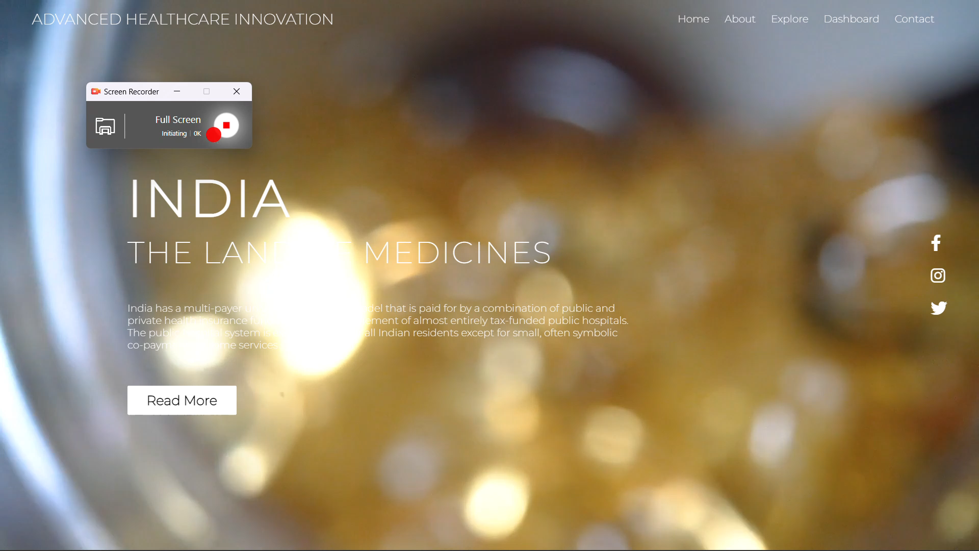

Slide 13
ABOUT PAGE

Slide 14
EXPLORE PAGE

Slide 15
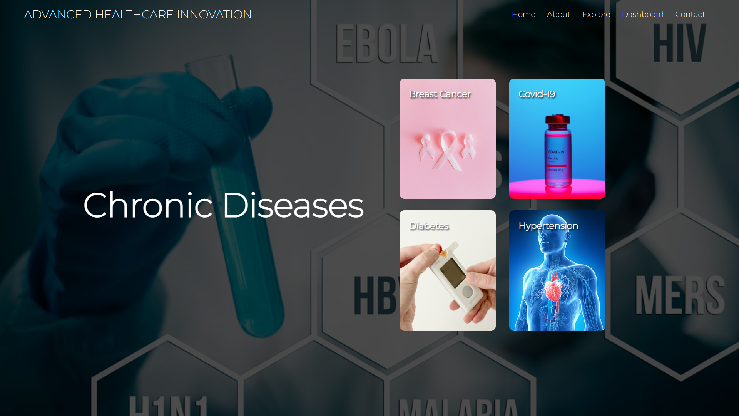

Slide 16
DASHBOARD

Slide 17
CONTACT

Slide 18
REFERNECES
https://bit.ly/3i8f4gT
https://bit.ly/3gtFARc
https://bit.ly/3tRWhca (Data)

Slide 19
UTPAL MISHRA
TEAM

Slide 20
Thank you!

